Slide 1
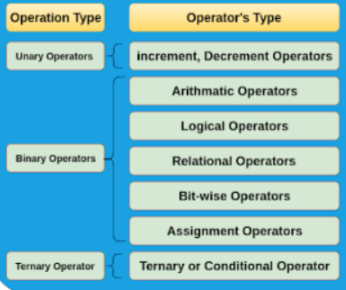
Operators in C
C supports a rich set of built-in operators.
An operator is a symbol that tells the computer to perform certain mathematical or logical manipulations.

Slide 2
Operators in C
Arithmetic Operators
Operates on any built-in data types
Example operators:
1) + (Plus) – Give sum as a result. Example: 3+2=5
2) – (Minus) – Give the difference as a result. Example: 4-2=2
3)
* (Asterisk)
– Used for multiplication and give the product as a
result.
Example: 4*2=8
4) / (Forward slash) – Used for division and give result. Example: 4/2=2
quotient as a
5) % (modulus) – Give the remainder as a result. Example: 7%2=1

Slide 3
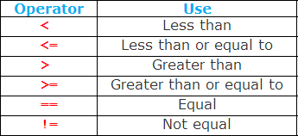
Operators in C
Relational Operators
To compare two quantities, and depending on their relation, take certain decisions.
Eg. a>b

Slide 4
Operators in C
Logical Operators
The logical operators are used to test more than one conditions and make decisions.
Example Operators:
Logical AND Logical OR Logical NOT
&&
||
!
Eg. a>b && a>c

Slide 5
Operators in C
Assignment Operators
It is used to assign the results of an expression to a variable.
Syntax:
Example:
x += y+1
x = x + (y+1);
var op = exp;
var = var op (exp);
var – variable, op – binary arithmetic operator, exp - expression

Slide 6
Operators in C
Increment and Decrement Operators
Increment operators (++): Example: (++x)
Decrement operators (–): Example: (--m)
These operators can be prefix operator or postfix operator.
Prefix increment operator: ++m is equivalent to m=m+1 or m+=1
Postfix increment operator: a = m++ -j+10, in this case the expression is evaluated first using the original value of the variable and then variable is incremented.

Slide 7
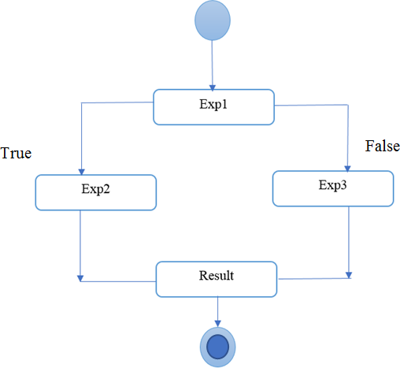
Operators in C
Conditional Operator
A ternary operator pair “:?” is available in C to construct conditional expressions of the form:
Syntax: exp1 ? exp2 : exp3 Example: x = (a>b) ? a : b;

Slide 8
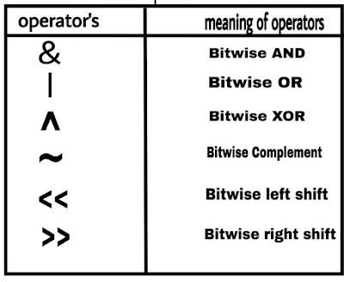
Operators in C
Bitwise Operator
Used for manipulation of data’s at bit level.
Used for testing the bits, or shifting them right or left

Slide 9
Operators in C
Special Operators
The comma operator – used to link the related expressions together Example: value = (x=10, y=5, x+5);
The sizeof operator – returns the number of bytes the operand occupies Example: m = sizeof(sum);
Pointer operator (& and *)
Member selection operator (. and ->)

Slide 10
Operator Precedence and Associativity
C has precedence associated with it.
This precedence is used to determine how an expression involving more than one operator is evaluated
The operators at the highest level are evaluated first
The operators at the same precedence are evaluated either from left to right or from right to left, depending on the level. This is known as associativity property of an operator.
Consider the conditional statement, if (x == 10 + 15 && y < 10) if (x == 25 && y < 10)
// Precedence rule: addition operator has highest priority than logical and relational
operators

Slide 11
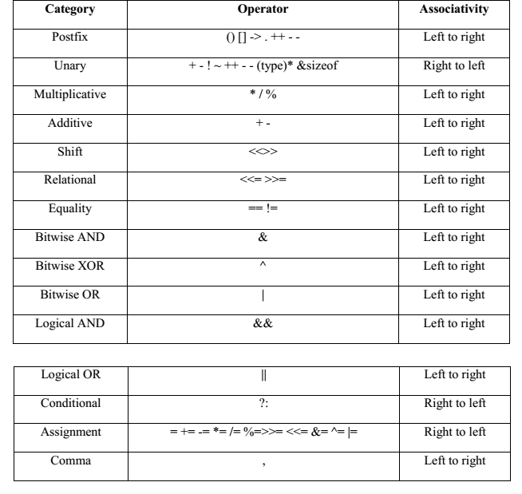
Precedence of Arithmetic Operators

Slide 12
Precedence of Arithmetic Operators
An example:
#include <stdio.h> int main()
{
float a,b,c,x; a=9; b=12; c=3;
x= a - b / 3 + c * 2 - 1; printf("x=%f", x); return 0;
}
OUTPUT?

Slide 13
How to read data from keyboard?
Scanf(“control string”, &variable1, &variable2,..);
Scanf(“%d”, &number);
Example:
#include <stdio.h>
int main()
{
int a,b,sum;
printf("Enter the value for A and B: "); scanf("%d %d", &a, &b);
sum=a+b; printf("Sum=%d", sum); return 0;
}

Slide 14
Simple C Programs
Program: To print a text
#include <stdio.h> int main()
{
printf("Hello, World! \n"); return 0;
}

Slide 15
Program: Display Variable Value
#include <stdio.h> main()
{
int number; float amount; number=100;
amount=32.75+53.50; printf("%d", number); printf("\n%4.2f", amount);
//return 0;
}
#include <stdio.h> int main()
{
int a=50; int b=5;
//a=50, b=5; int c=a+b;
printf("Sum of %d and %d is: %d", a, b, c);
}

Slide 16
Program: Find the area of the square
#include<stdio.h> int main() {
int side, area;
printf("\n Enter the Length of Side : "); scanf("%d", &side);
area = side * side;
printf("\n Area of Square : %d", area); return (0);
}

Slide 17
Program to calculate simple interest.
#include<stdio.h> #include<conio.h> int main()
{
float p,rate,time,si;
printf("Enter principal amount : "); scanf("%f", &p);
printf("Enter rate of interest : ");
scanf("%f", &rate);
printf("Enter time period in year : "); scanf("%f", &time);
/*calculating simple interest*/ si=(p*time*rate)/100; printf("\nSimple Interest = %f",si);
getch();
return 0;}

Slide 18
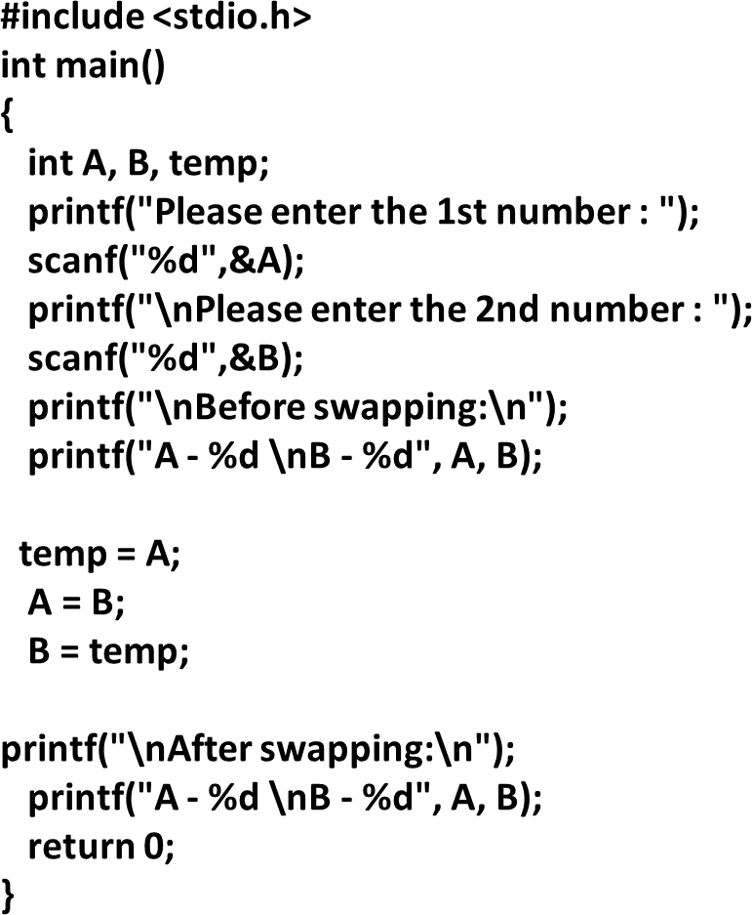
Program to swap two numbers.

